Slide 1
Your logo
Fill your business sector with : Automotive ; Business Support & Supplies ; Computers & Electronics ; Construction & Contractors ; Education ; Entertainment ; Food & Dining ; Health & Medicine ; Home & Garden ; Legal & Finance ; Manufacturing, Wholesale, Distribution ; Merchants (retails) ; Miscellaneous ; Personal care & professional services ; Real Estate ; Tourism & Hospitality
Business Sector
Your innovation & company's photos
Your Title
Your text
Fill in your texts with the same colors, fonts, sizes
An innovative tool of Franco Thai Chamber to ease connections !
Your text
Information you want to highlight
Your text
Your innovation & company's photos
Your text
Your QR code

Slide 2
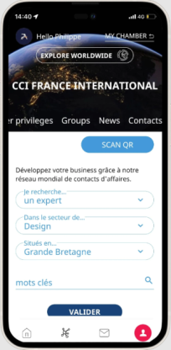
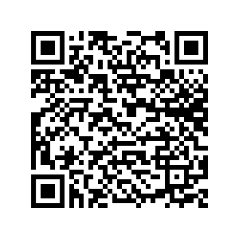
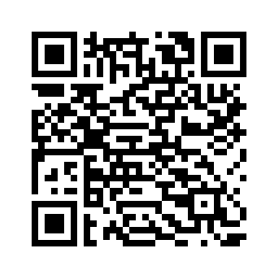
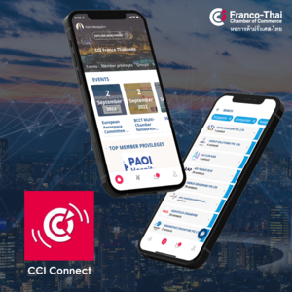
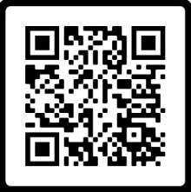
IT / Technology
Example of FTCC
In this context we decided to develop the new mobile application CCIFI Connect. Reserved exclusively to the members of the FTCC, it has been designed to facilitate networking and exchanges between members, to give them access to the complete agendas of events all over the world, and help them take advantage of exclusive offers in many countries!
CCIFI Connect
An innovative tool of Franco Thai Chamber to ease connections !
Franco-Thai Chamber of Commerce, under the support by French Chambers of Commerce and Industry Abroad (CCIFI), is now developing the new initiative to improve and engage the business network among FTCC business community. As we all realized that the network, plays an important role in the animation of French business community both in Thailand and abroad also, it helps support French companies who want to expand internationally.
A global and multilingual platform, a springboard for
✓ Explore the world
✓ Meet experts
✓ Make new connections
✓ Take advantage of exclusive offers
✓ Benefit from exclusive information
A CCI France International application, in partnership with BlueSoft and with the support of CCI France. It allows you to discover more than 4,000 events per year and to network efficiently by contacting speakers or participants. Moreover, this application allows you to search among more than 70,000 contacts by affinity, need, sector or country and thus develop your business.
In addition, you can enjoy more than 1000 unique benefits for all your business needs in more than 40 countries: Hotel, Travel, Business, Lifestyle...

